Slide 1
Online Shopping Website
Le garderobe
Megan Sydiaha, Shirin Nasir, Hossein Nazarpour
Notes:
Well, Our team consists of Me, Megan and hosein. we decided to work on an online clothing shopping website for men, women and kids.

Slide 2
Development Process
Planning
The purpose
Target Audience
Content
Sketching page layout
Notes:
Through the planning phase of the development process, first we checked out some online shopping websites for inspiration. We discussed what is the purpose of our website and who is gonna be served in our website.
Then by the help of the reference websites I mentioned, we figured out the information we are gonna display for our pages.
And lastly we came to a conclusion and started drawing a primary sketch by hand which later became our mockup.

Slide 3
Purpose
Enable the customers to browse range of products
Provide photos, specifications, features and prices of the products
Provide a bilingual online shopping experience
Provide information about promotions and sales
Affiliated with a physical store
Notes:
Well, firstly our website actually represents a brick and mortar store, selling men and women clothing and accessories where you can browse what’s available in the physical store as well as online shopping.
So the website enables customers to browse the products, there are photos and description available for each product, also we offer a bilingual website for improved user experience and also to boost search engine visibility.
And as I said before the website is affiliated with a physical store

Slide 4
Target audience
People who
like convenience
like better deals
like having choices
have a specific taste not met by traditional stores
Notes:
But who are the target audience?
All the people that like convenience, they can buy their clothing from the comfort of their own home. And the people who want to be informed of the latest deals and promotion or those who have specific taste, they have more choices online with spending less time compared to shopping from traditional stores

Slide 5
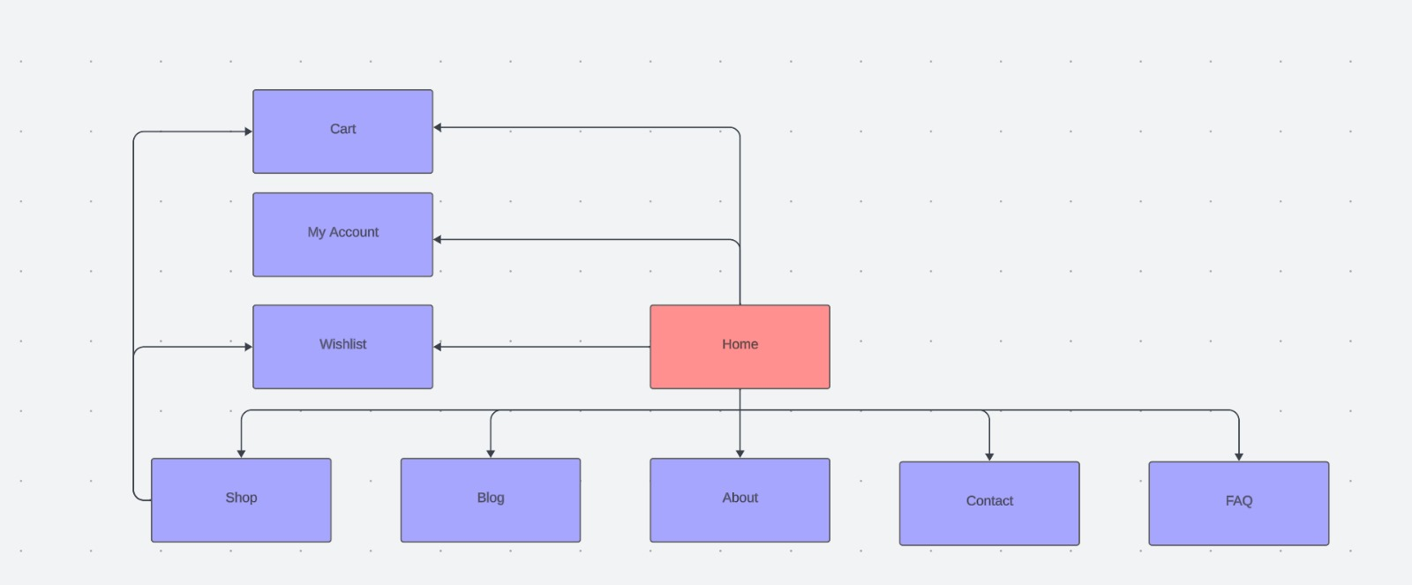
Site Map
Notes:
This is our site map or navigation structure
These are the pages that almost any online shopping website should have.
To be more detailed we created another sitemap to include the categroies of shop page and the product page.

Slide 6
Navigation Structure
Home page
Account
Contact
About
Shop
Men
Women
Kids
Accessories
Clothing
Kids
Product
Product
Blog
FAQ
Cart
Wishlist
Notes:
We got to a conclusion that each of us take one of the essential pages of the site and design and implement it. So I went with homepage, Hosein with product page and Megan with contact page.

Slide 7
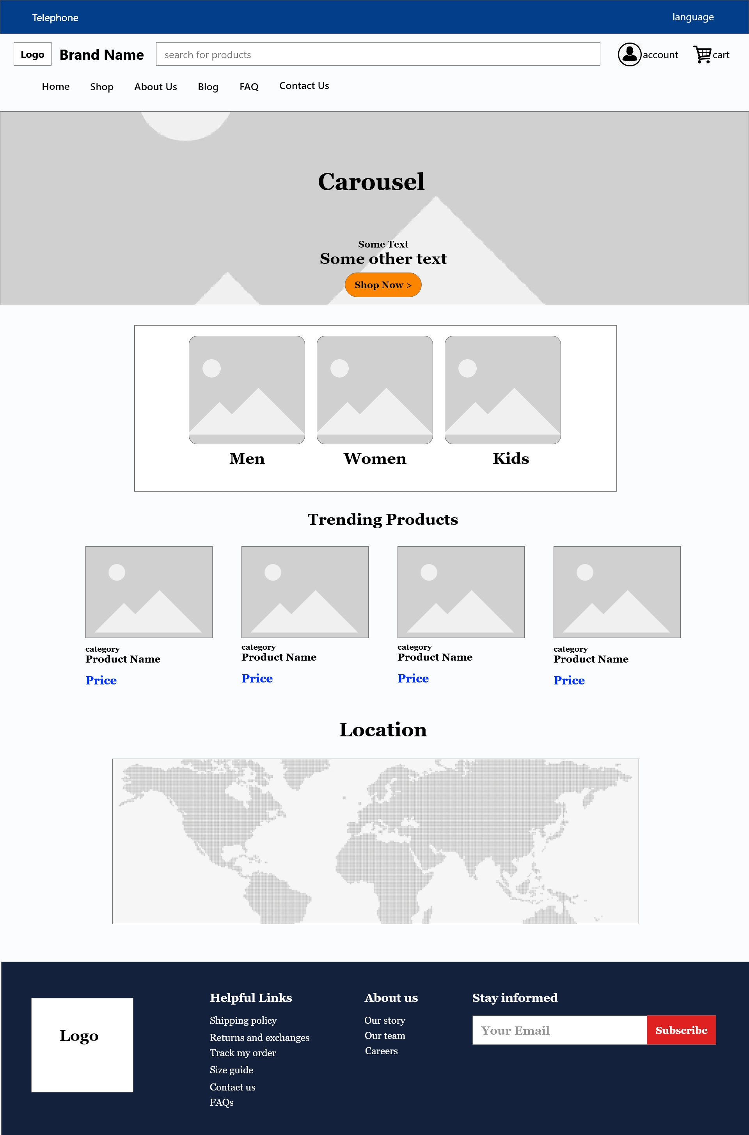
Home Page Layout
Notes:
Based on the sketch we designed by hand, we used adobe xd to create the mockup for our pages. We tried to stay minimal but to cover all the essentials of an online shopping website.
This is home page, we agreed to have a carousel at top. Showing any deals or new arrivals. Because you know It may be tempting for the customer
But right up tha page there is a language and support bar
Then comes the categories for men …
After that, a section for trending products, those that are best sellers
And lastly the location, you know as I said there is also a physical store in this business
In the footer we covered some other stuff

Slide 8
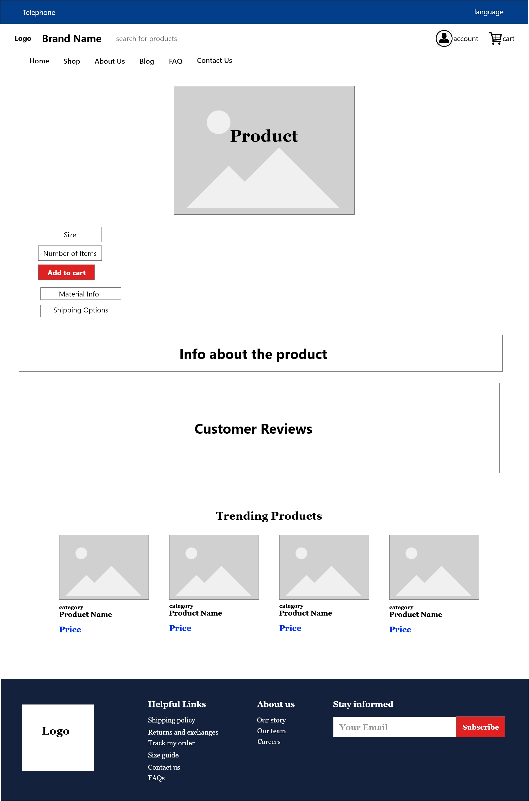
Product page Layout
Notes:
This is the mockup for product page, we have the product photo and info
Hosein will present it in detail

Slide 9
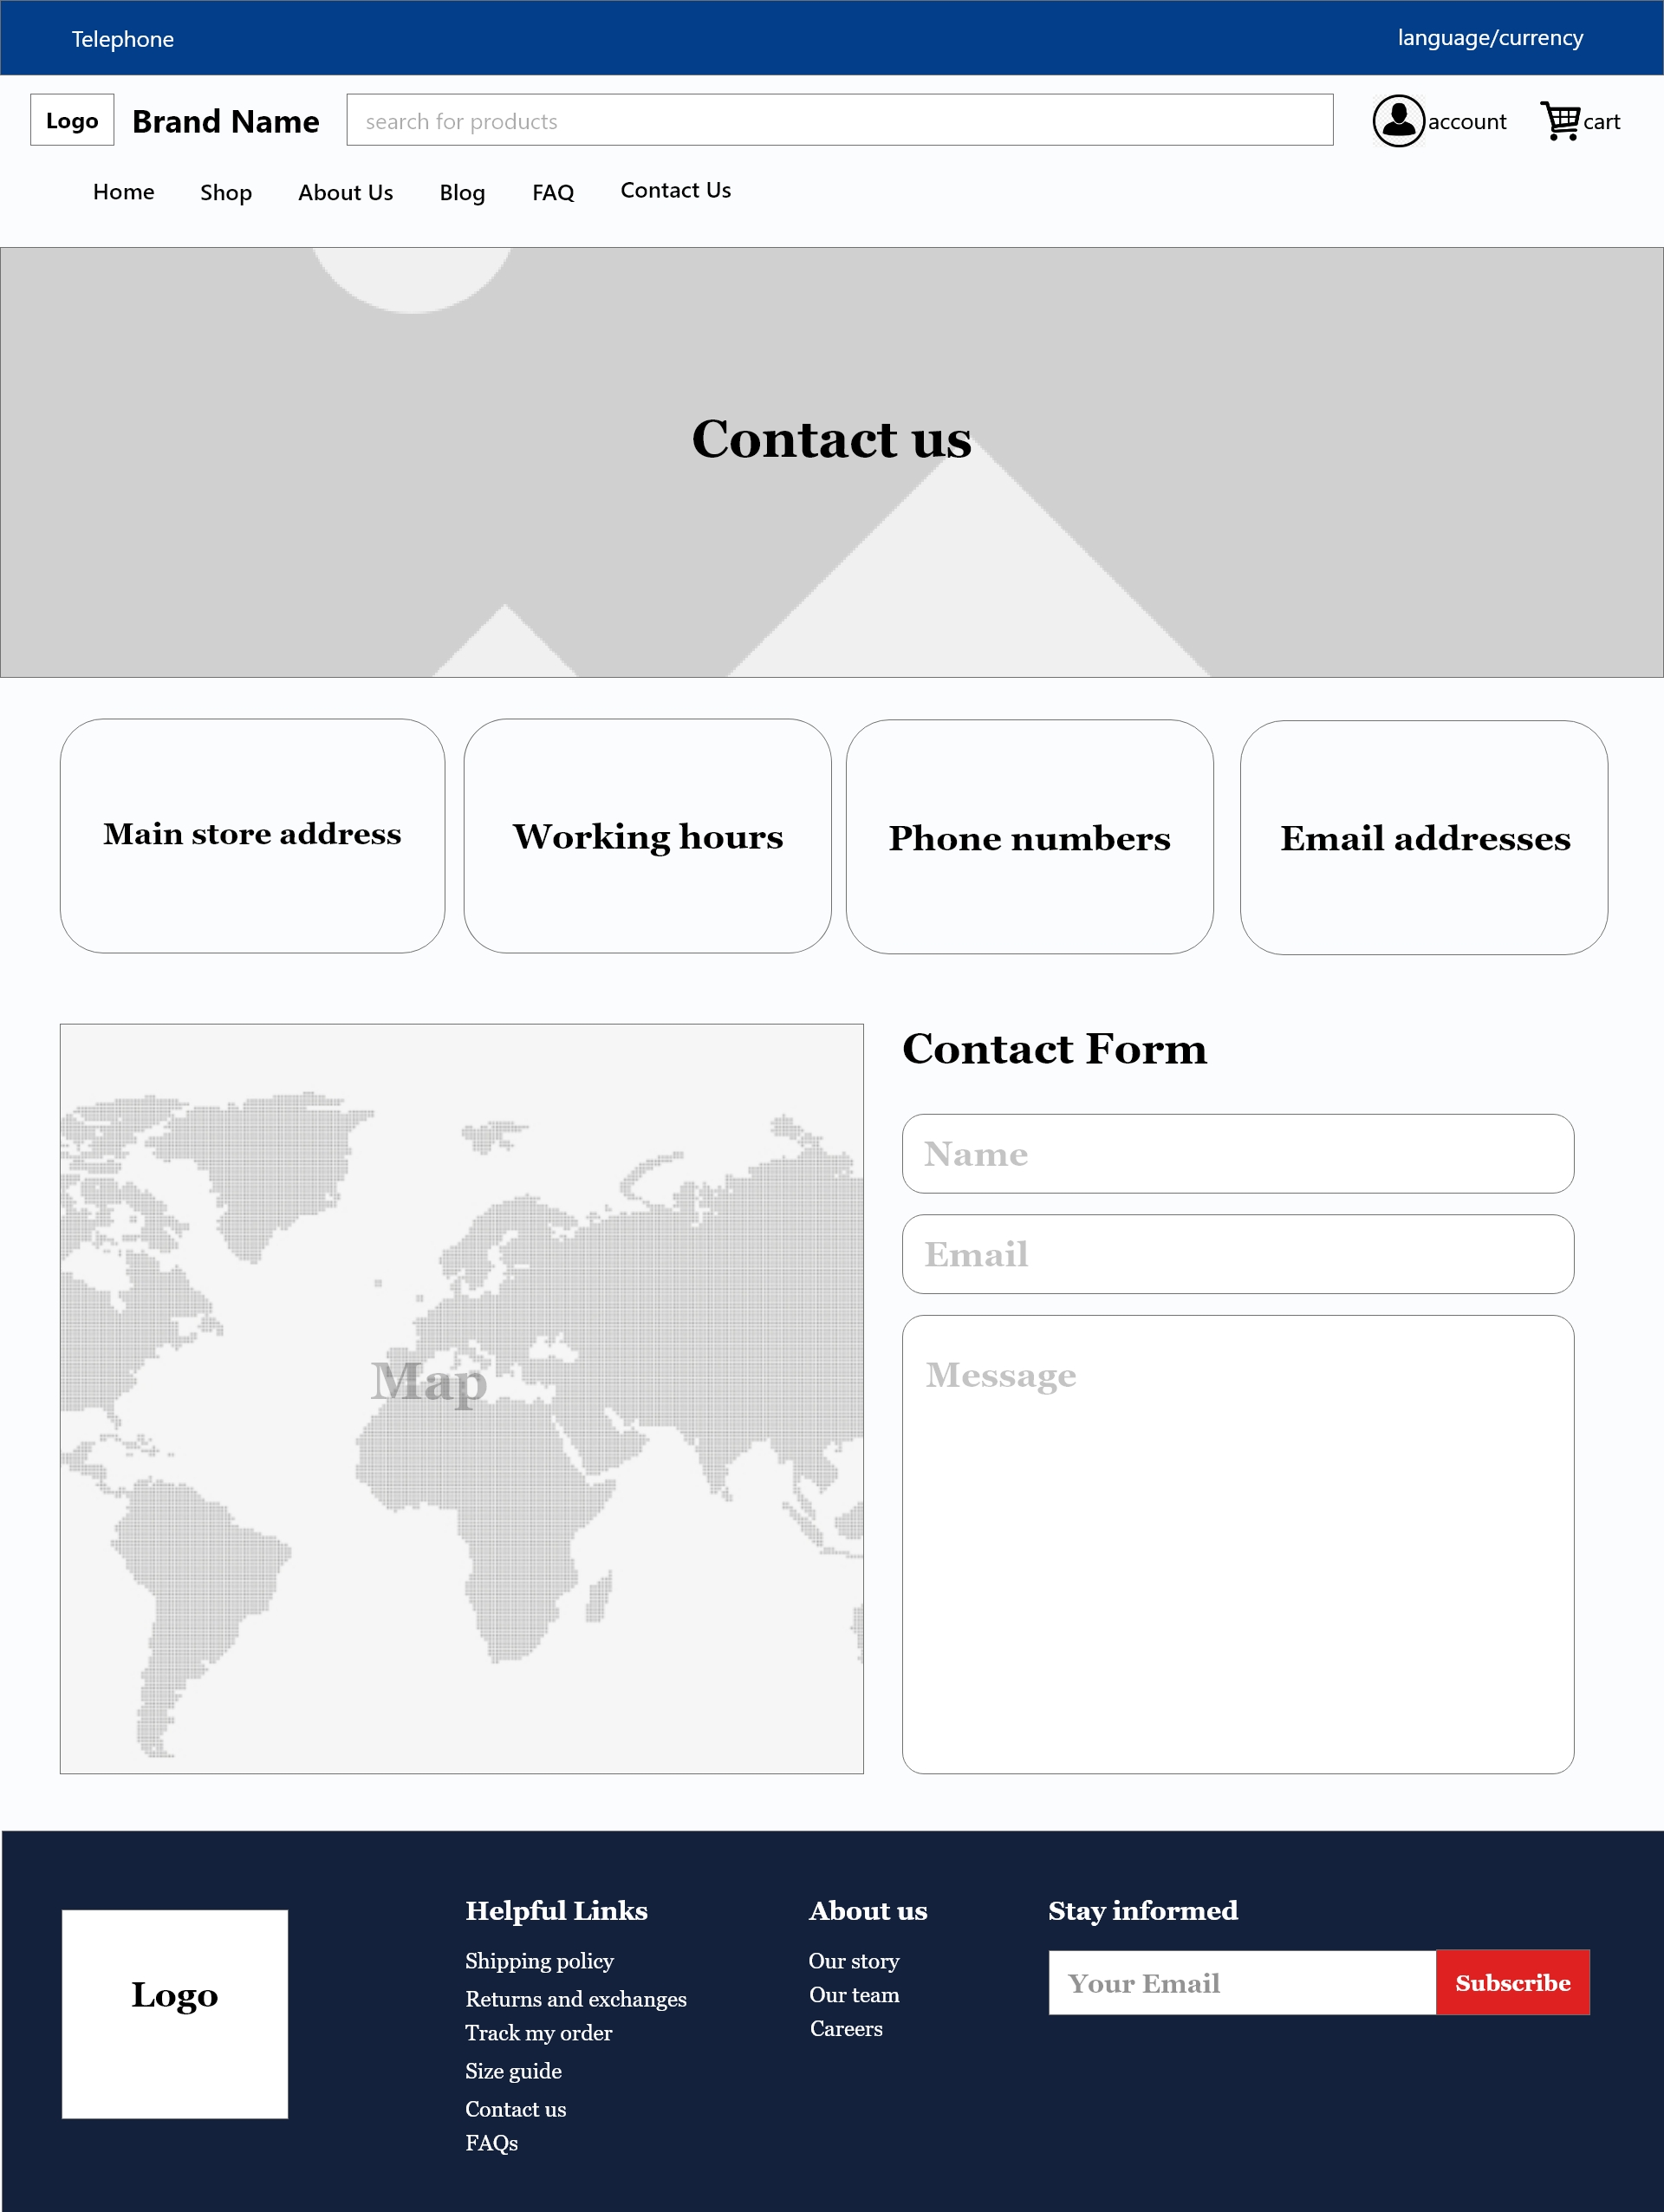
Contact Page Layout
Notes:
And this is megan page, contact page
A hero image on top with information on the contact ways, working hours and so on
There is also a contact form where users can leave a comment or ask questions

Slide 10
Reference websites
murriatelier.com , 1861.ca , gravitypope.com
Framework
Bootstrap
Logo, brand name, and color theme
Coolors.co, logo.com
Notes:
So these are the sites we got inspired from, the layout the color palette and so

Slide 11
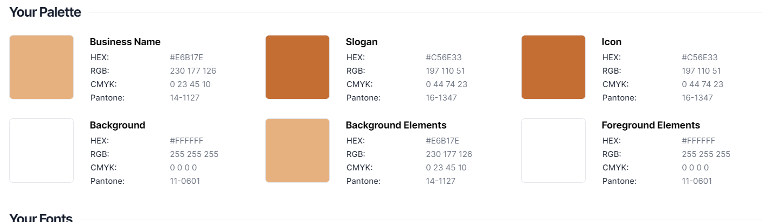
Website color palette
Notes:
This is our color palette we chose using the coolors.co
We tried to have limited colors as was mentioned in terrymorris checklist

Slide 12
Thank you
Megan Sydiaha
Shirin Nasir
Hossein Nazarpour

